Slide 1
Applications of Derivatives

Slide 2
Contents:
Definition of Derivative
Mean Value Theorem
Rate of Change of Quantities
Real life Applications
5. Conclusion

Slide 3
Definition of Derivative:
The Derivative is the exact rate at which one quantity changes with respect to another.
Geometrically, the derivative is the slope of curve at the point on the curve.
The derivative is often called the
“instantaneous “ rate of change.
The derivative of a function represents an infinitely small change in the function with respect to one of its variables.
•
The Process of finding the derivative is called “differentiation.”

Slide 4
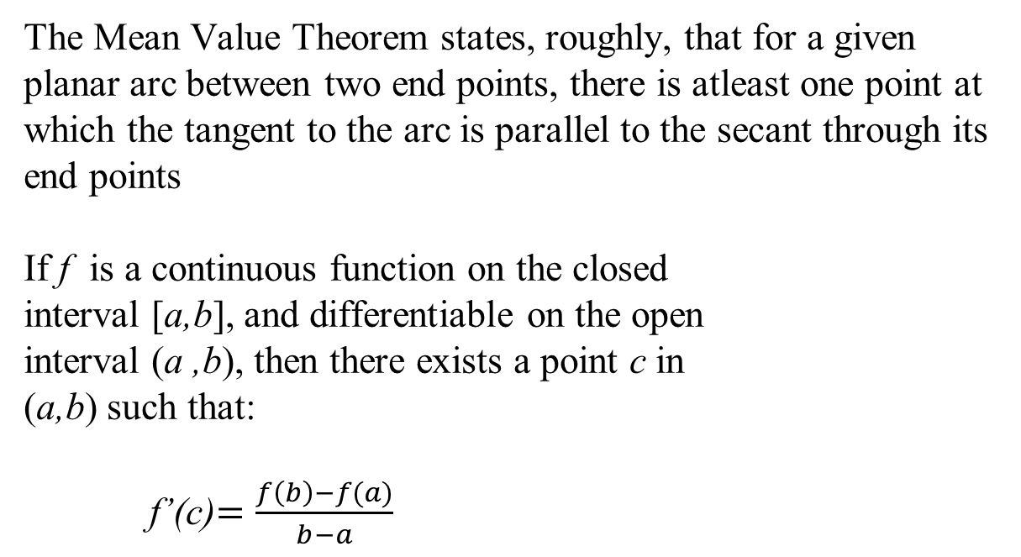
Definition of Mean Value Theorem
The Mean Value Theorem states, roughly, that for a given planar arc between two end points, there is atleast one point at which the tangent to the arc is parallel to the secant through its end points
If f is a continuous function on the closed
interval [a,b], and differentiable on the open
interval (a ,b), then there exists a point c in
(a,b) such that:
f’(c)$=\frac{f\left(b\right)−f(a)}{b−a}$

Slide 5
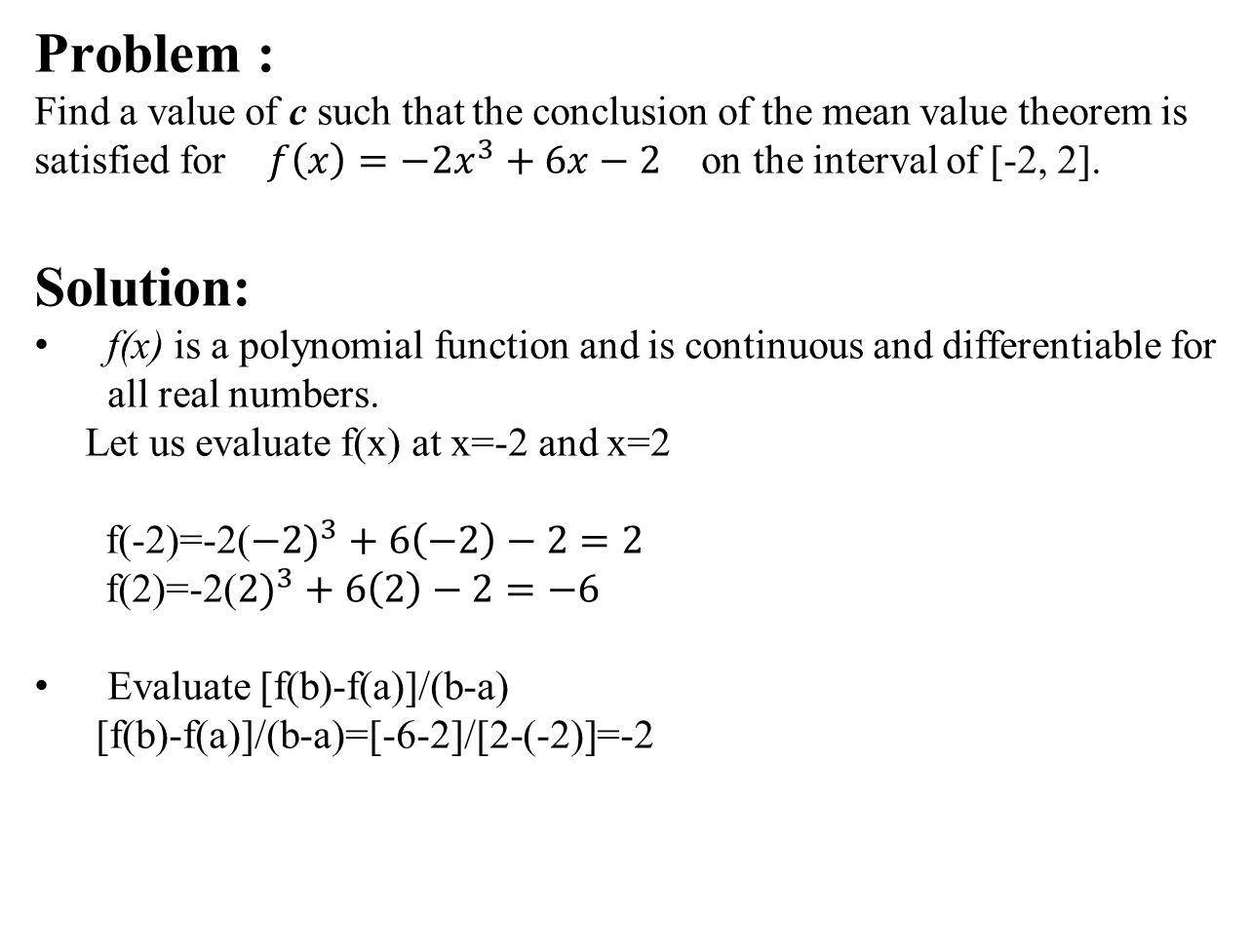
Problem :
Find a value of c such that the conclusion of the mean value theorem is satisfied for $f\left(x\right)=−2x^{3}+6x−2$ on the interval of [-2, 2].
Solution:
f(x) is a polynomial function and is continuous and differentiable for all real numbers.
Let us evaluate f(x) at x=-2 and x=2
f(-2)=-2(${−2)}^{3}+6\left(−2\right)−2=2$
f(2)=-2(${2)}^{3}+6\left(2\right)−2=−6$
Evaluate [f(b)-f(a)]/(b-a)
[f(b)-f(a)]/(b-a)=[-6-2]/[2-(-2)]=-2

Slide 6
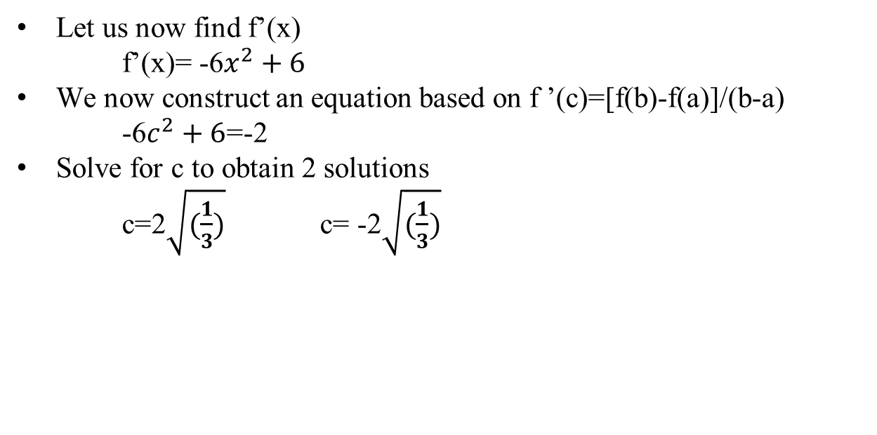
Let us now find f’(x)
f’(x)= -6$x^{2}+6$
We now construct an equation based on f ’(c)=[f(b)-f(a)]/(b-a)
-6$c^{2}+6$=-2
Solve for c to obtain 2 solutions
c=2$\sqrt{(\frac{1}{3})}$ c= -2$\sqrt{(\frac{1}{3})}$

Slide 7
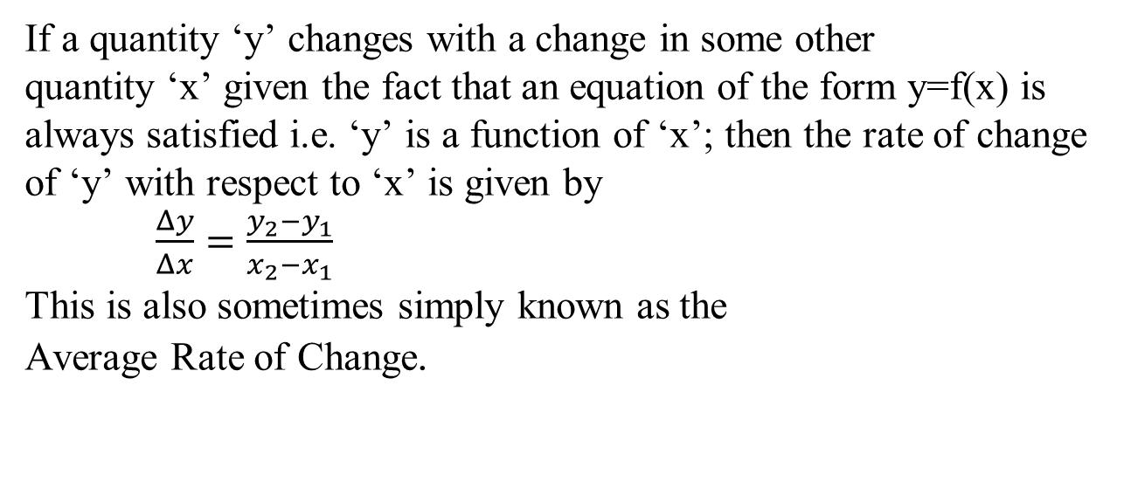
Definition of Rate of Change of Quantities
=y2–y1x2–x1
=y2–y1x2–x1
=y2–y1x2–x1
If a quantity ‘y’ changes with a change in some other
quantity ‘x’ given the fact that an equation of the form y=f(x) is always satisfied i.e. ‘y’ is a function of ‘x’; then the rate of change of ‘y’ with respect to ‘x’ is given by
$\frac{Δy}{Δx}=\frac{y_{2}−y_{1}}{x_{2}−x_{1}}$
This is also sometimes simply known as the
Average Rate of Change.

Slide 8
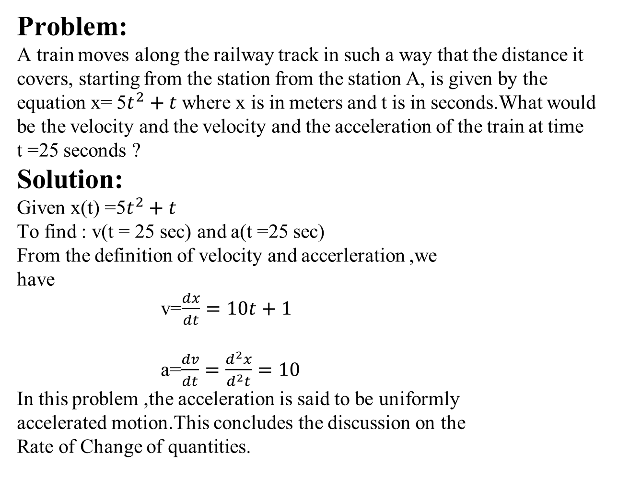
Problem:
A train moves along the railway track in such a way that the distance it covers, starting from the station from the station A, is given by the equation x= 5$t^{2}+t$where x is in meters and t is in seconds.What would be the velocity and the velocity and the acceleration of the train at time t =25 seconds ?
Solution:
Given x(t) =5$t^{2}+t$
To find : v(t = 25 sec) and a(t =25 sec)
From the definition of velocity and accerleration ,we
have
v=$\frac{dx}{dt}=10t+1$
a=$\frac{dv}{dt}=\frac{d^{2}x}{d^{2}t}=10$
In this problem ,the acceleration is said to be uniformly
accelerated motion.This concludes the discussion on the
Rate of Change of quantities.

Slide 9
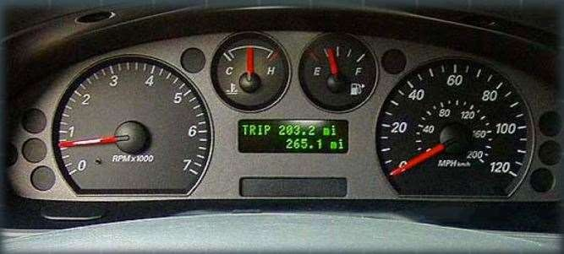
Automobiles
Real life Applications of Derivatives
In an automobile there is always an odometer and a speedometer. These two gauges work in tandem and allow the driver to determine his speed and his distance that he has travelled. Electronic versions of these gauges simply use derivatives to transform the data sent to the electronic motherboard from the tires to miles per Hour(MPH) and distance(KM).

Slide 10
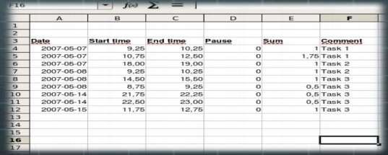
Business
In the business world there are many applications for derivatives. One of the most important application is when the data has been charted on graph or data table such as excel. Once it has been input, the data can be graphed and with the applications of derivatives you can estimate the profit and loss point for certain ventures.

Slide 11
Conclusion:
Derivatives are constantly used in everyday life to help measure how much something is changing. They're used by the government in population census, various types of sciences, and even in economics. Knowing how to use derivatives, when to use them, and how to apply them in everyday life can be a crucial part of any profession, so learning early is always a good thing.

Slide 12


